Slide 1

AI-Based Intelligent Traffic Light Control System
Using Classical Search Algorithms
Ali Ahmed, Yassin Tamer, Yassin Mohamed, Ezzeldin Amr, Mohamed Wael
| Course: Artificial Intelligence | Instructor: Dr. Farid Zaky
Notes:
1

Slide 2
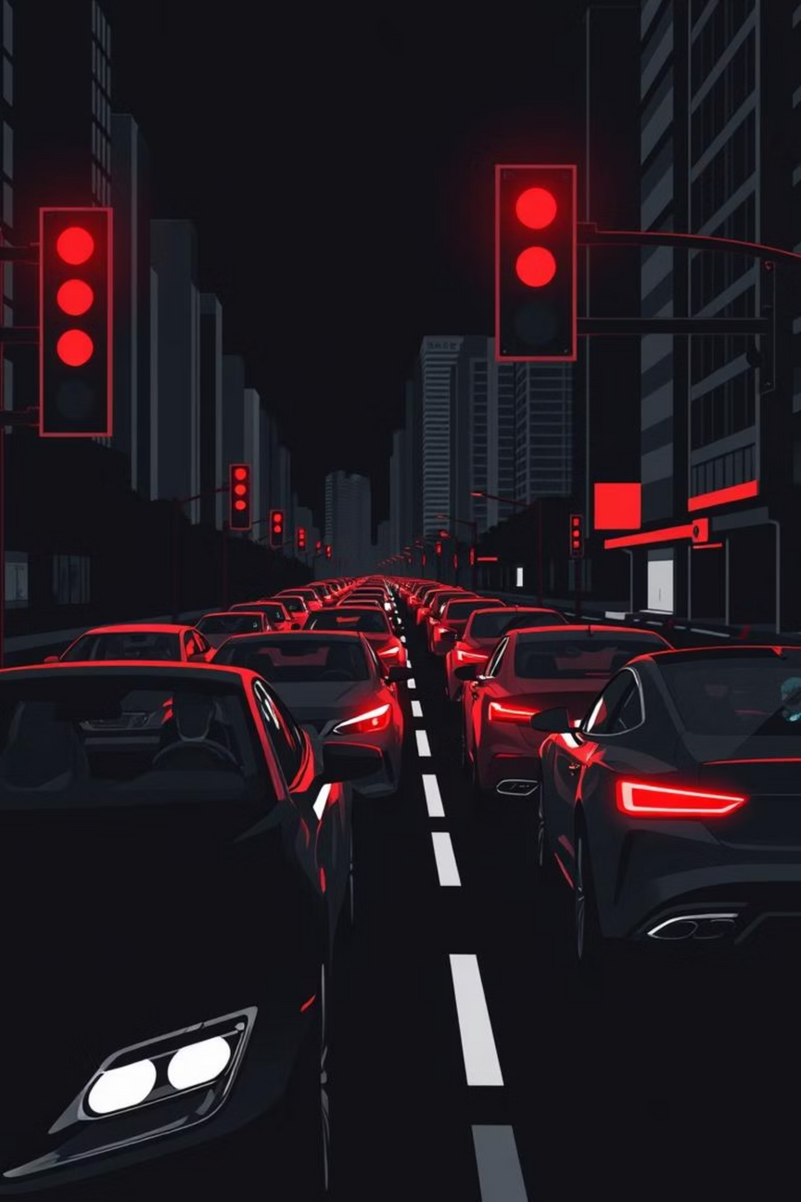

The Problem: Fixed Traffic Timing
Inefficiency of Traditional Systems
Consequences of Fixed Timing
Traditional traffic light systems rely on predetermined, fixed timing schedules, which fail to adapt to the reality of dynamic traffic flows.
Severe traffic congestion, especially during peak hours.
Excessive waiting times for drivers.
Inability to respond effectively to sudden traffic changes.
Our Goal: Intelligent Optimisation
To address this, we developed an intelligent decision-making system using AI planning algorithms with the objective of minimising the total waiting time for vehicles at an intersection.
Notes:
2

Slide 3

System Architecture Overview
Core Components
Graphical User Interface
Traffic Environment Simulation
Traffic Environment Simulation: Provides a realistic, dynamic input environment.
State Representation: Defines the current situation for the AI agent.
Visualize results and controls
AI Planning Algorithms: The decision engine (AI agent).
Realistic dynamic input
Performance Evaluation
State Representation
Intelligent Traffic System
Assess system outcomes
Current traffic snapshot
Agent Decision Loop
The AI agent continuously analyses the state and decides the optimal action at the intersection: either HOLD the current light phase or SWITCH to the next phase.
Cost & Heuristic Functions
AI Planning Algorithms
Optimize route and timing
Decision engine for control
Notes:
3

Slide 4
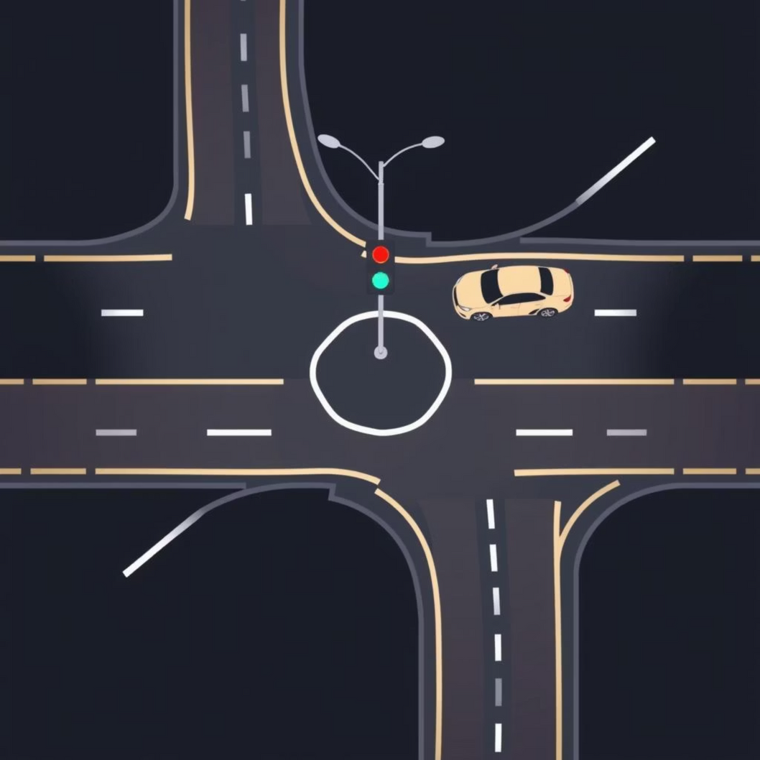
State Space and Cost Model
State Representation
Cost Function
The primary metric for evaluating any given state is the total number of waiting cars. This forms the basis for the search algorithm's pathfinding.
Cost = Total Waiting Cars
The objective of the AI is to minimise this cost, directly leading to better traffic flow and reduced congestion.
The state is defined by a tuple, capturing all necessary information for the AI to make a strategic decision:
Waiting Cars: Queues in North, South, East, and West directions.
Current Phase: Which direction has the green light (NS or EW).
Time in Phase: Duration the current phase has been active, enforcing minimum green times.
Notes:
4

Slide 5



State Transition Logic: Prediction vs. Reality
Planning Transition (Deterministic)
Used by the search algorithms to predict future states. It assumes deterministic car arrivals and ensures minimum green time rules are respected.
Simulation Transition (Realistic)
Mimics the real-world traffic environment. It incorporates random car arrivals and departures, providing a dynamic and unpredictable environment for testing the AI.
The AI agent uses the deterministic planning model to explore possible actions (HOLD or SWITCH) before executing the chosen action in the realistic simulation environment.
Notes:
5

Slide 6
Comparing AI Search Algorithms
We evaluated five classical search algorithms to determine the most effective approach for real-time traffic control decisions. Each algorithm selects the optimal action (HOLD or SWITCH) based on its search strategy.
Breadth-First Search (BFS)
Depth-First Search (DFS)
Uniform Cost Search (UCS)
A* Search
Iterative Deepening DFS (IDDFS)
Notes:
6

Slide 7


A* Search: The Optimal Choice
A* Search emerged as the best-performing algorithm, primarily due to its efficient balance of exploring the search space and incorporating problem-specific knowledge via heuristics.
The Evaluation Function
g(n): The actual cumulative cost from the initial state (total waiting cars so far).
h(n): The heuristic estimate of the cost to reach the goal (estimated waiting cars, often using maximum traffic in any direction).
Fast Execution
1
Guaranteed Optimal
2
Balanced Decisions
3
Notes:
7

Slide 8
Simulation and Performance Metrics
The system undergoes extensive simulation to validate the AI's effectiveness against fixed-time controls.
Simulation Run
Execution & Update
Each test runs for 300 time steps, providing sufficient data for analysis.
The chosen action is applied, and the traffic environment is updated accordingly.
Planning
At every step, the AI forecasts future states and determines the optimal action.
Key Performance Indicators (KPIs)
Total
Avg
Total Waiting Cars
Average Wait Time per Car
Switches
Time
Number of Light Switches (Efficiency)
AI Execution Time (Latency)
Notes:
8

Slide 9
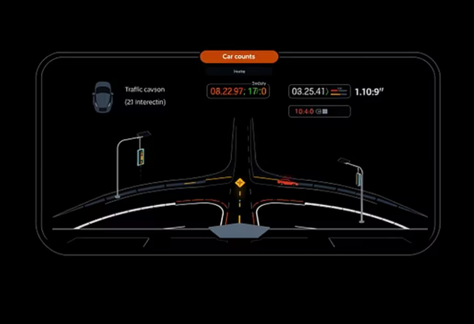

Graphical User Interface (GUI) Visualisation
A custom GUI, developed using Tkinter, provides a clear, interactive visual representation of the traffic control system in action. This aids in understanding the AI's decision-making process.
Visual Feedback
User Controls
Real-time intersection layout and traffic light status.
Pause and Resume the simulation.
Dynamic car counts for all four directions.
Reset the environment for new test runs.
Display of the current phase and the AI's chosen action.
Adjust simulation speed for detailed observation.
Notes:
9

Slide 10
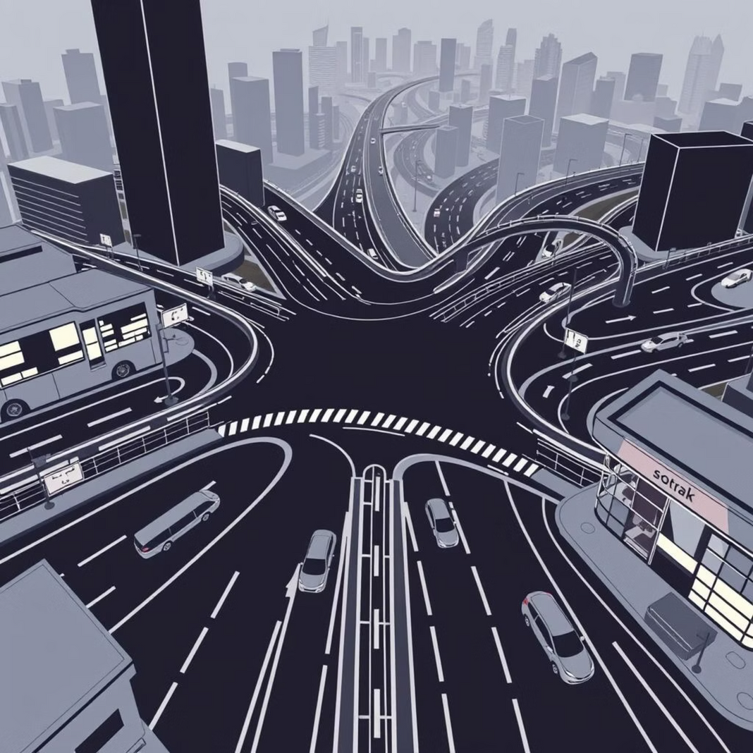



Conclusion and Future Directions
Key Conclusions
Future Work
1
AI search algorithms offer a substantial improvement over fixed-time systems in traffic flow optimisation.
2
The A* algorithm demonstrates the best overall performance, providing an optimal balance between fast execution and solution quality.
3
Intelligent planning based on traffic conditions significantly reduces overall congestion and waiting times.
Multi-Intersection Systems
Reinforcement Learning
Real Traffic Data Integration
Thank You for Your Attention. Questions?
Notes:
10

